Slide 1
Activation of mTORC1 and Suppression of Autophagy in Muscle Tissue Shortens Lifespan in Mice and Flies

Slide 2
Background
mTORC1 inhibition increases lifespan in many organisms, tissue not known
Activation of mTORC1 in skeletal muscle known to impair autophagy (Benztinger 2013) and increase whole body energy expenditure (Stephenson in prep, Guridi 2015)
Impaired autophagy increases lifespan (several papers), tissue of action is unclear.
Hypothesis: mTORC1 activation and autophagy inhibition, specifically in muscle tissue, reduces lifespan in flies and mice

Slide 3
Muscle Tsc1 Knockout Mice Have Shortened Lifespan
Solid line is knockout
Males only
Heart/SkM Knockout
Hazard Ratio 4.17
p=2.0 x 10⁻⁵
Cause of deaths not known (would need to send carcasses to vet pathologist)

Slide 4
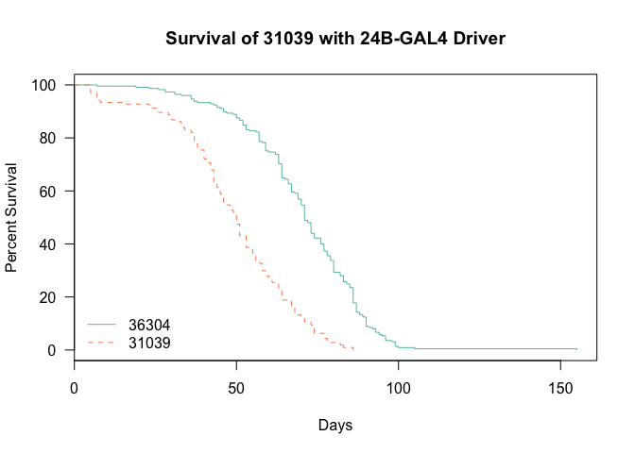
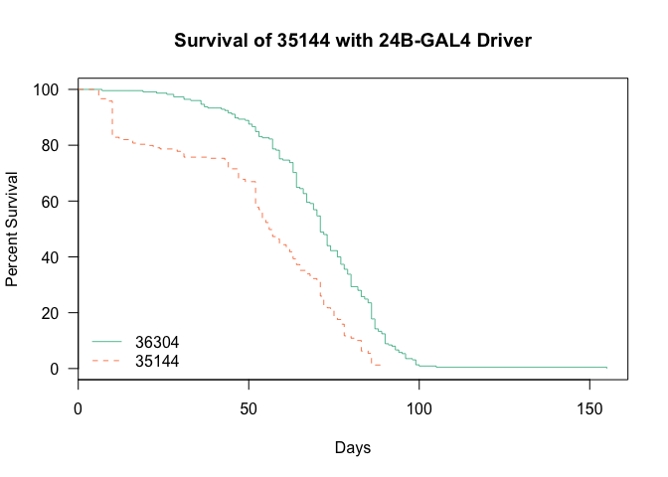
Knockout of Tsc1 in Fly Flight Muscles Shortens Lifespan
GAL4/UAS System
24B Driver
2/3 shRNA for Tsc1 caused reduced lifespan
Hazard ratios are 3.5X and 2.2X for two shRNAs (p<1x10⁻⁵)
True for both genders for both shRNA that had effect
Third shRNA probably nonfunctional (no phenotype with SSI assay)

Slide 5
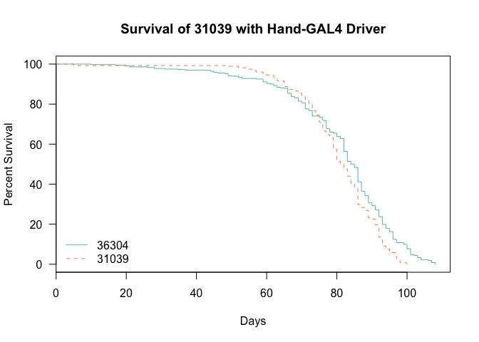
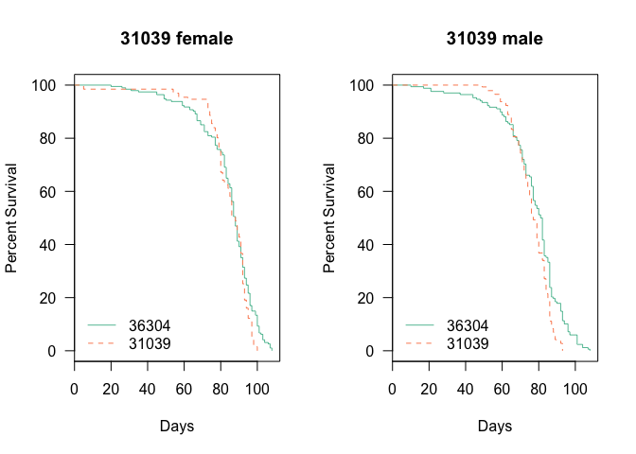
No Effect of Cardiac Tsc1 Knockout
Used Hand-Gal4 driver
No effect on males or females
Only tested one shRNA, but it was one that had effect in 24B-Gal4 driven knockout

Slide 6
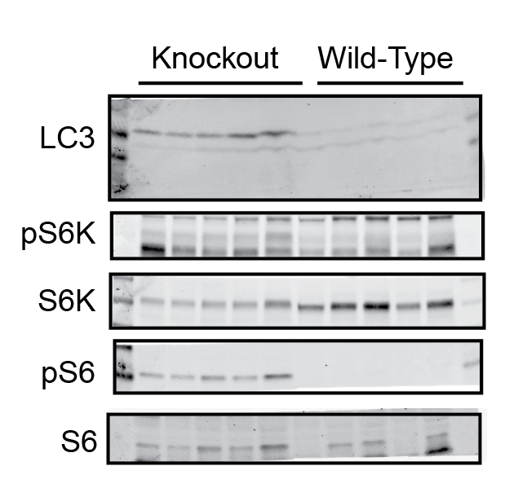
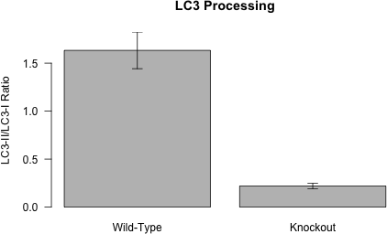
Knockout of Muscle Tsc1 Impairs Autophagy
Blots showing activation of mTORC1/reduced LC3 processing from quadriceps of mice
Could do in heart if necessary
RNAseq (in Stephenson paper) shows upregulation (mRNA) of Ulk1/Ulk2/Map1lc3b/Tfeb and downregulation of Atg4b, Gabarapl1, Map3ca, Atg10, Atg12, Atg16l1, Wipi1 and Wipi2 could recheck these by qPCR in different lysates
LC3 Protein (total and un-processed) is higher in knockouts, not sure which gene this represents, but might be Map1lc3a which is up transcriptionally
Previously shown using different Cre by Bentzinger (2013)

Slide 7
Knockout of Atg8a in Fly Muscles Shortens Lifespan
This is genetic impairment of autophagy in skeletal muscles
No effect for Atg5 or Atg8b
Hazard ratio is 3.57 (p < 1 x 10⁻⁶)
Have this data for all these strains (1 shRNA each) in 24B-Gal4 driver knockouts, for both genders.
Didn’t measure autophagy directly in the flies

Slide 8
Climbing Assay Data
Probably have this somewhere, the hypothesis would be that climibing ability is reduced as these flies age faster, but I need to find it

